Slide 1

Sentiment Analysis of COVID-19 Tweets – Visualization Dashboard
Prepared By:- Janki Patel
Aneri Shah
Sanjeev Khatwani
Team name:- Emo-co-ti
College:- LDRP – ITR,
Gandhinagar

Slide 2


Technologies and Software used:
Node Red
Cognos Dashboard
Tone Analyser
Jupyter Notebooks (python)
Excel

Slide 3

Phases Involved:
Fetching Data and Data Pre-Processing
Using Scraping for getting data in Jupyter Notebooks
3. Using Pre-Processed Data For ML
4. Predicting the mood if the lockdown extends
5. Plotting various visualizations and getting insights

Slide 4
6. Making the UI in NODE RED
7. Sentiment wise analysis of tweets (Cognos Dashboards)
8. Tone wise analysis of tweets (Cognos Dashboards)
9. Location-wise analysis using dashboards
10. Allowing users to analyse their tweets before posting

Slide 5
Fetching data and Data Pre-processing:
We used the Twython Library to fetch the tweets from the tweet ids that were mentioned in (IEEE csv files).
We intentionally chose the dates on which Lockdown announcements were done to get insights on people’s mood.
Then we processed the data by cleaning it using various techniques (removed the stop words ‘#’, ‘@’, hyperlinks etc.).

Slide 6
Using Scraping for getting data in Jupyter Notebooks:
For scraping (India) we have used the data from the Ministry of health and family welfare website (https://www.mohfw.gov.in)
For scraping (India) we have used the data from the Worldometer website (https://www.worldometers.info/coronavirus/#countries)

Slide 7

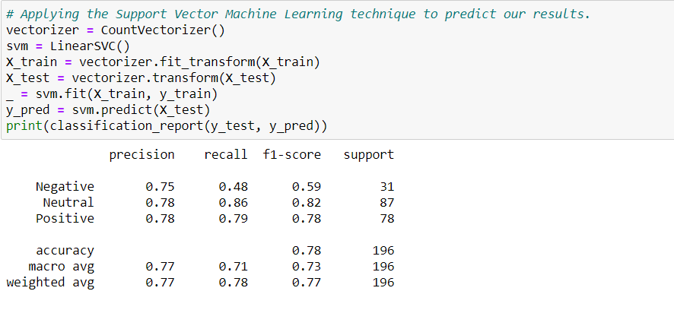
Using Pre-Processed Data For ML:

Slide 8

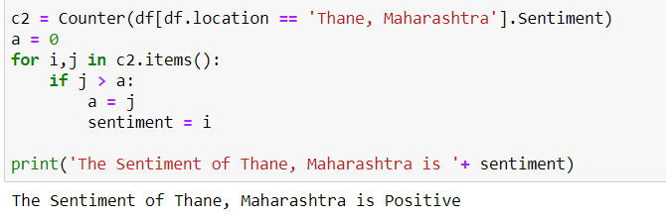
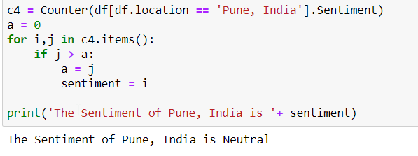
Predicting the mood if the lockdown extends

Slide 9

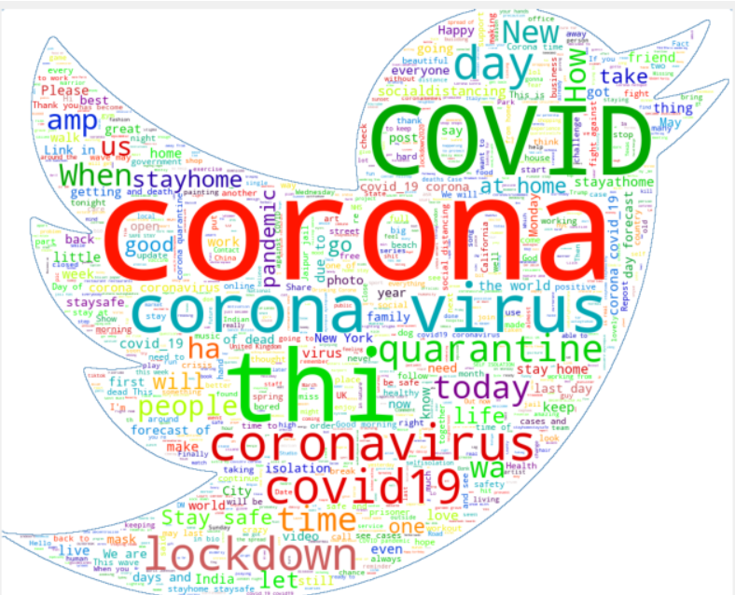
Plotting various visualizations and getting insights:

Slide 10

Making the UI in NODE RED:
The Node Red UI contains 3 main elements
The Sentiment Analysis dashboard
The Location wise analysis
The Tweet Analyser

Slide 11
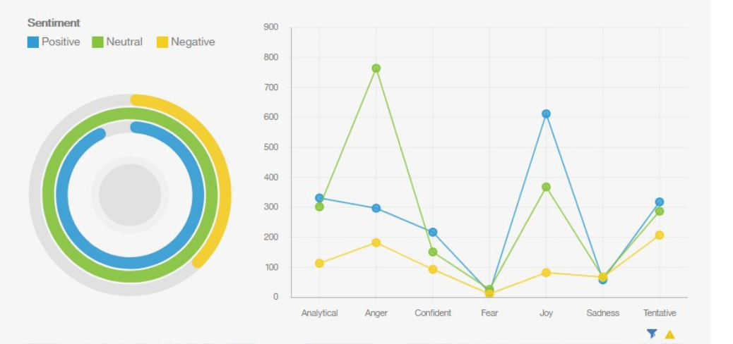
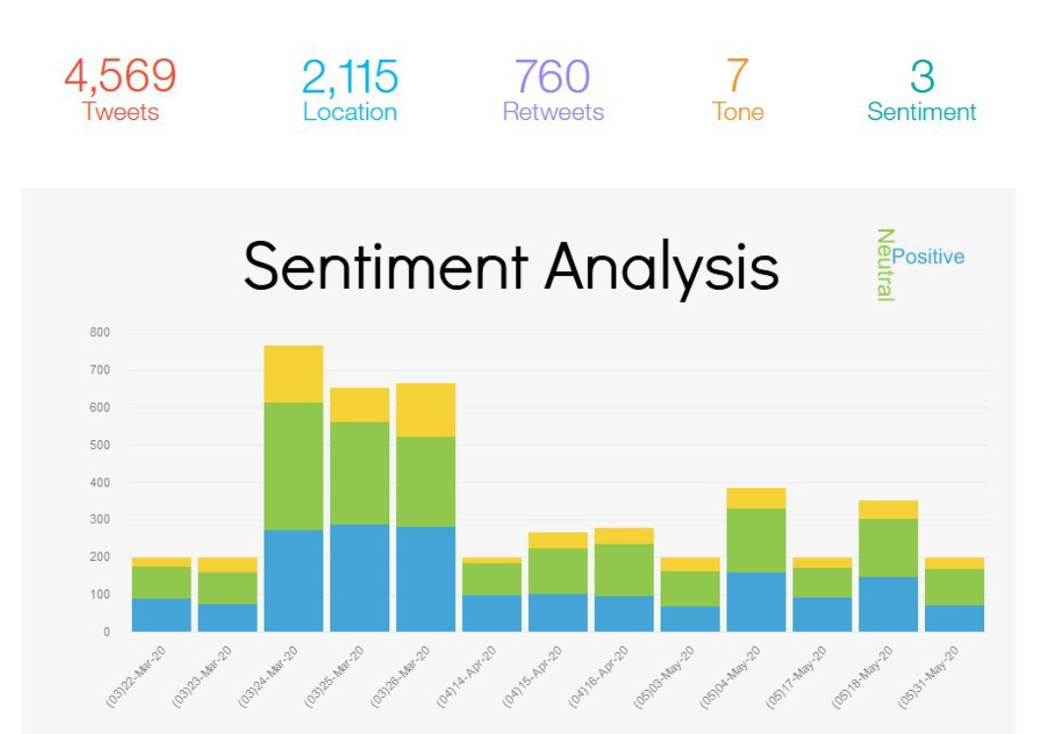
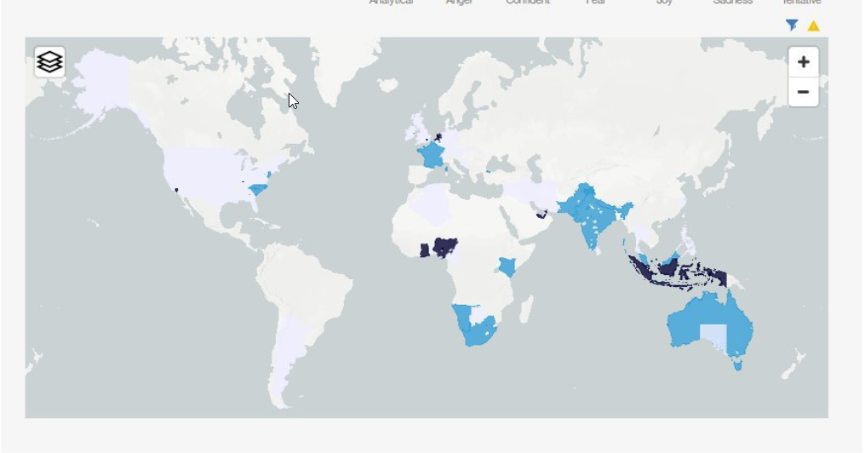
Using the pre-processed data in Cognos Dashboards:

Slide 12
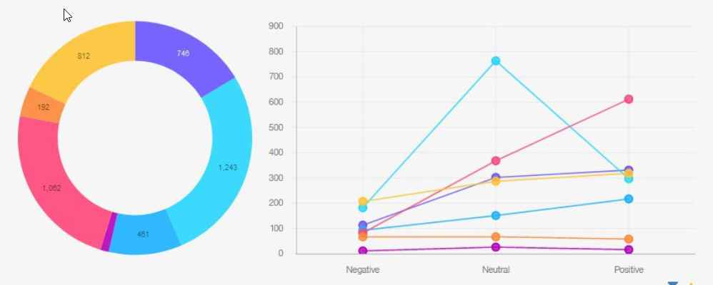
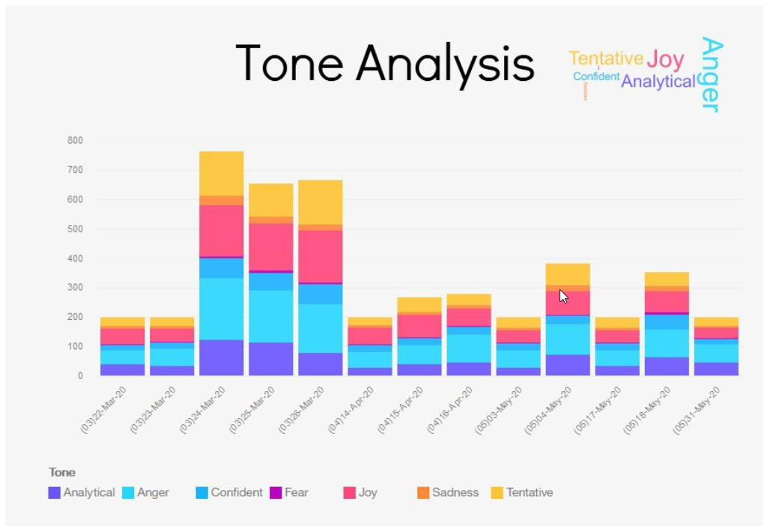
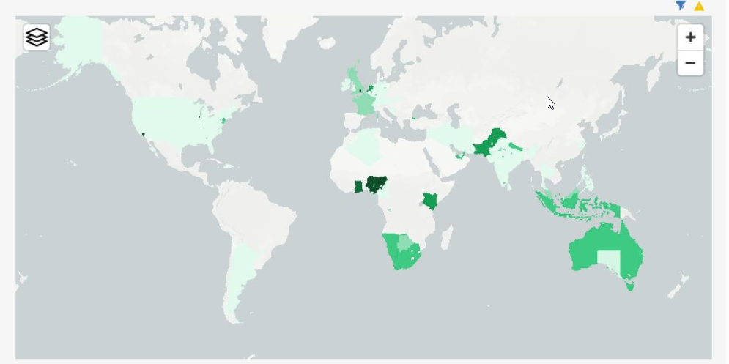
Tone wise analysis of tweets:

Slide 13
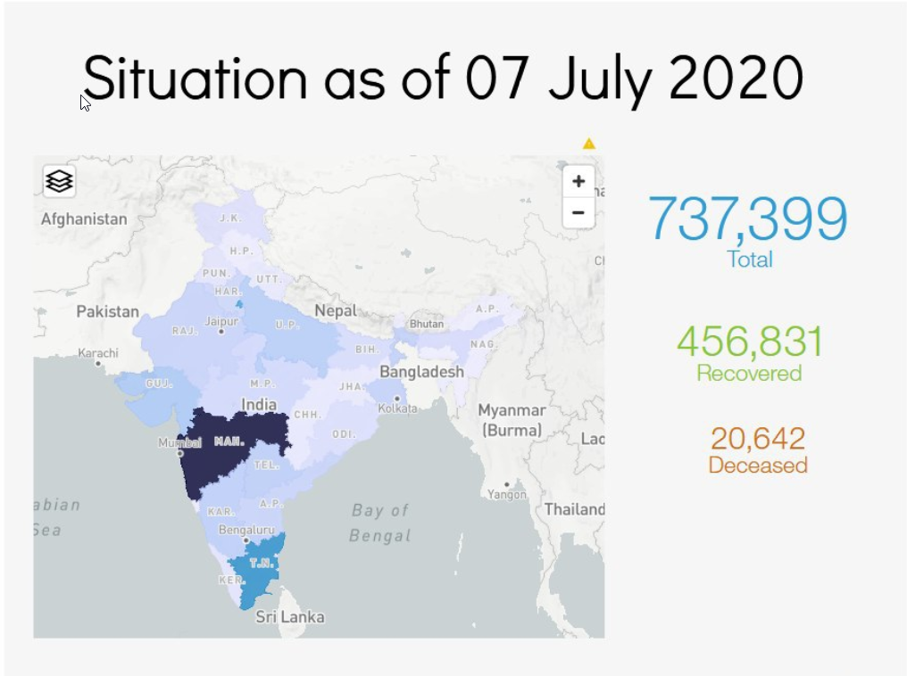
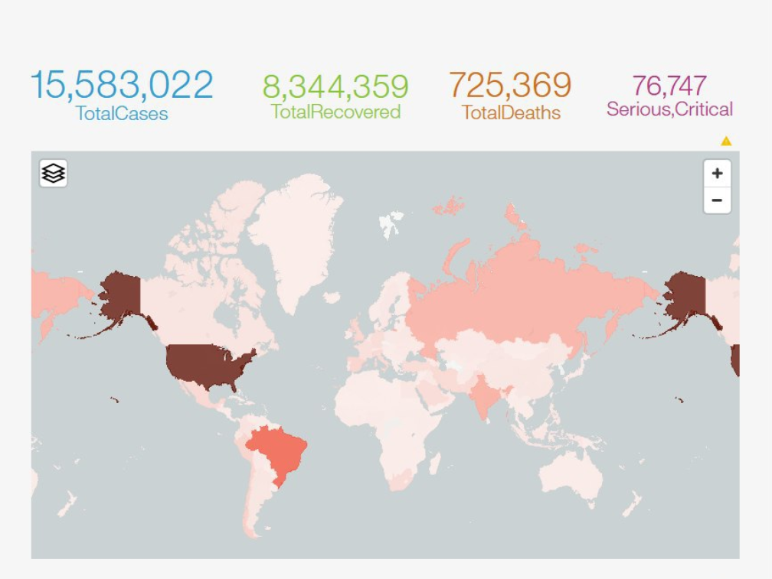
Location-wise analysis using Cognos dashboards:

Slide 14
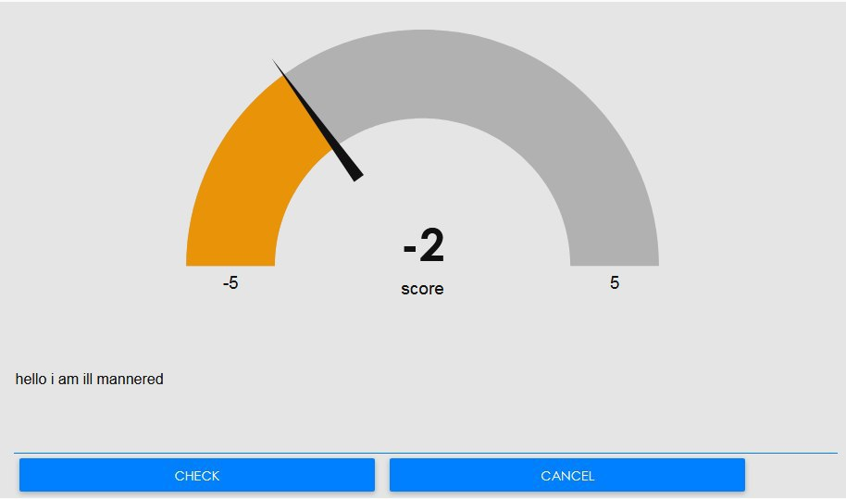
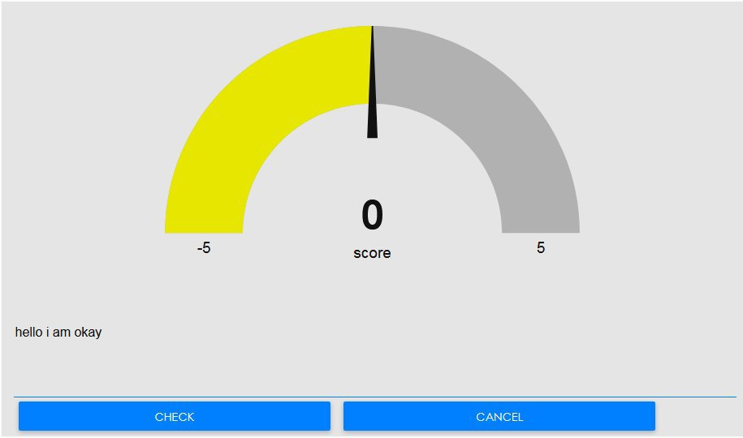
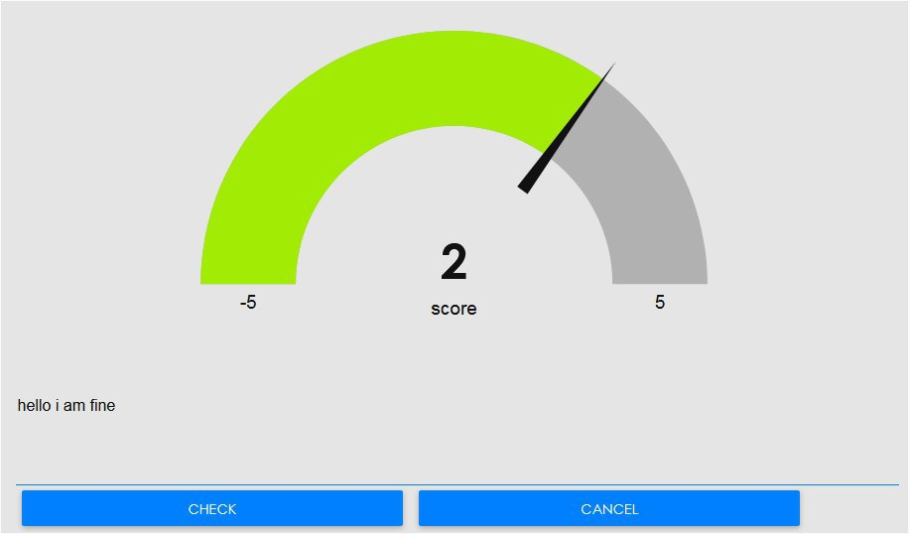
Allowing users to analyse their tweets before posting:
We have added a functionality which lets the user check what is the sentiment of his tweet before posting

Slide 15


